Slide 1
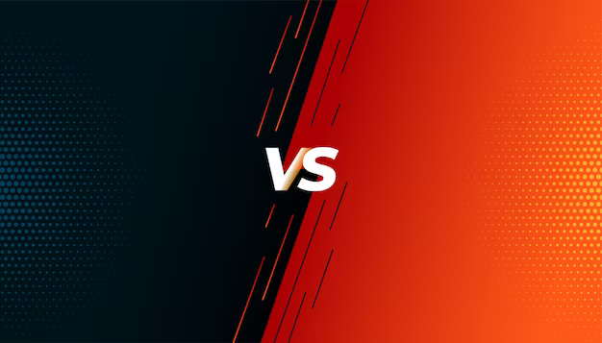
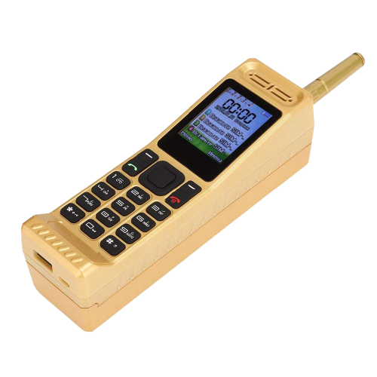
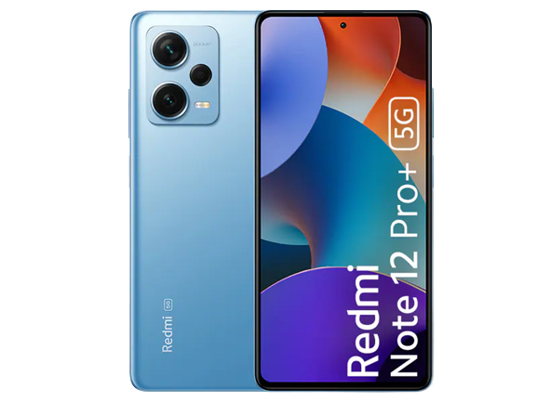
Old Mobile
New Mobile
Comparison Between Old Mobile and New Mobile

Slide 2

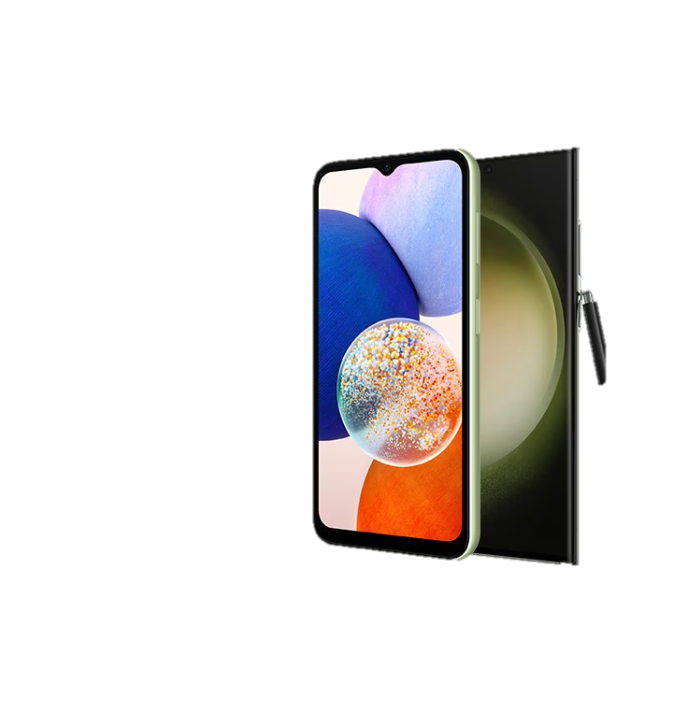
What is Mobile Device
A mobile phone is a portable telephone that can make and receive calls over a radio frequency link while the user is moving within a telephone service area, as opposed to a fixed-location phone.
Features of Mobile Phone
There is a great variety of mobile devices. Phones, tablets, e-readers, and other mobile devices share some common characteristics, including:
1. Small enough to be carried easily
2. Operates without a physical connection to electricity; uses a battery to store power
3. Able to send and receive information wirelessly, using cellular data, Bluetooth, or Wi-Fi
4. Features a user interface, such as a touchscreen or keyboard
5. Includes internal data storage
6. Often includes communication functions for voice or video calling
7. May include sensors to record and store information, such as a camera, compass, or activity monitor
Small devices that are designed to store but not send and receive information, such as external hard drives, are not considered mobile devices.

Slide 3
History of Mobile phone
The first handheld cellular mobile phone was demonstrated by John F. Mitchell and Martin Cooper of Motorola in 1973, using a handset weighing 2 kilograms (4.4 lb). The first commercial automated cellular network (1G) analog was launched in Japan by Nippon Telegraph and Telephone in 1979.
Introduce First Cellular Phone
The StarTAC, created by Motorola in 1996, was the phone that started the whole revolution of flip phones. Most people college age or older probably had some sort of flip phone in their life before the iPhone was introduced. This phone had basically all of the same capabilities of any other phone in its time, the main difference was the size and shape. The flip phone became very popular after this came out because of the convenience of it's size and mobility.

